Slide 2
Sermon on the Mount
Matthew 5-7

Slide 3
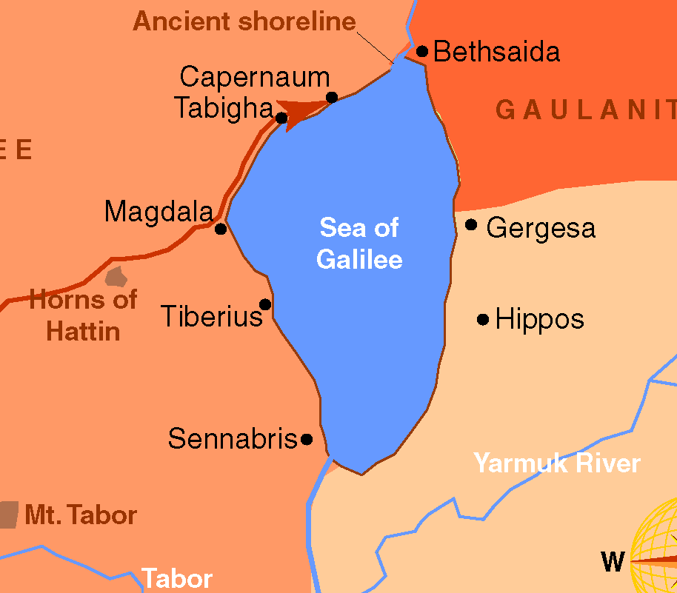
Sermon on the Mount
Matthew 5-7
Scene: the mountain
Luke 6:12 – went to mountain to pray then chose apostles – then came down with them – Mark 3:14,15
Luke 6:17 – came to a more level spot
Matthew: sat down (5:1)
Parallel in Luke 6:29-49

Slide 4
Sermon
on
the Mount
Matthew 5:13-16
SALT (v.13)
  Galatians 2:20 “Christ lives in me”
“OF THE EARTH”
  1 John 2:16,17 “is not of the Father but is of the world”
QUALITIES OF SALT
  Preserver – used to cure hams
  Penetrates – rids of moisture that leads to decay
  Purifies – soak injuries in salt
  Adds Taste – enhances food
1 Timothy 4:11,12 “example to the believers in word, in conduct, in love, in spirit, in faith, in purity”
1 Timothy 4:16 “take heed to yourself and to the doctrine”
1 Peter 3:1-4 “without a word, may be won by the conduct of their wives”

Slide 5
Sermon
on
the Mount
Matthew 5:13-16
“LOSES ITS SAVOUR” {KJV} “FLAVOR”
  Salt mingled with other substance loses its power
  Romans 12:2 “do not be conformed to this world”
  Malachi 2:6 “injustice was not found on his lips”
“HAMMY CHRISTIANS”
  Hammy Salt – salt that had taken the flavor of the MEAT!
  Such salt would have no value!
  Some professed Christians offer this kind of salt to the Lord!
  Mix and Mingle with the world – but the world is none the better for it!
  HAMMY SALT! HAMMY CHRISTIANS!
  “good for nothing, but to be cast out. And to be trodden under foot of men”

Slide 6
Sermon
on
the Mount
Matthew 5:14-16
“LIGHT” (vv. 14-16)
  The world needs illuminating
  People have gone away from God into darkness
  John 3:19 “men loved the darkness rather than light, because their deeds were evil”
CHRISTIANS ARE LIGHT
  Ephesians 5:8 “but now you are light in the Lord”
  Philippians 2:15 “among whom you shine as lights in the world”
  God is “the Light,” and we are illuminated by Him
  1 John 1:5-7 “God is light … if we walk in the Light as He is in the light”
  Don’t try to enhance the light of the Gospel!

Slide 7
Sermon
on
the Mount
YOU ARE SET UP TO SHINE!
“ON A HILL” “ON A CANDLESTICK”
  Mark 1:15 “Go into all the world”
  Matthew 4:15,16 “people who sat in darkness have seen a great light”
HOW DO WE SHINE?
  Good Works – Ephesians 2:10; Titus 2:7
  Declaring The Truth – 2 Corinthians 4:5,6
DANGER!
  NOT “Put it under a basket” “that they may see your good works and glorify your Father in heaven."

Slide 8
LIGHT IS A GOOD THING
God is light – 1 John 1:5
Christ is light – John 8:12His disciples are light – Matthew 5:14
The Gospel is light – 2 Corinthians 4:4
The Truth is light – John 3:21
Sermon on the Mount

Slide 9

TO BE LIGHT:
1. We must LIVE the light
2. We must be a powerful REFLECTION of God

